Slide 2
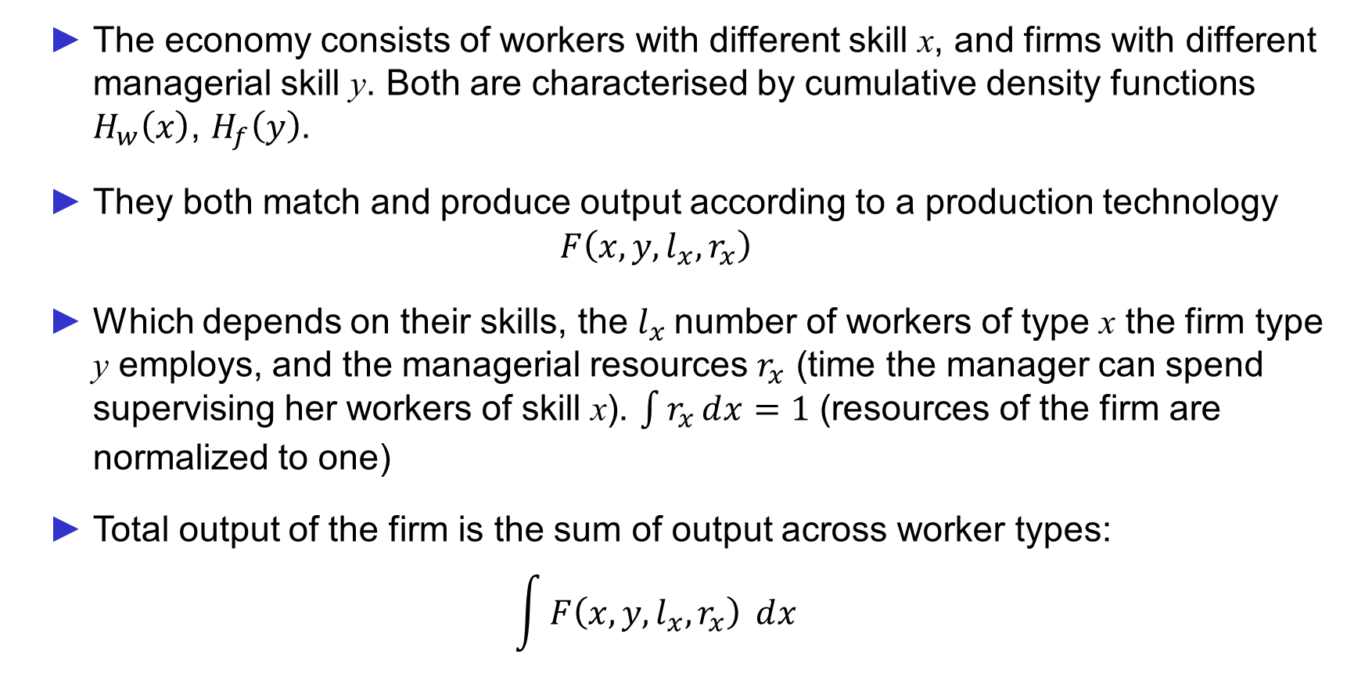
Model
The economy consists of workers with different skill x, and firms with different managerial skill y. Both are characterised by cumulative density functions $H_{w}\left(x\right)$, $H_{f}\left(y\right)$.
They both match and produce output according to a production technology
$$F\left(x,y,l_{x},r_{x}\right)$$
Which depends on their skills, the $l_{x}$number of workers of type x the firm type y employs, and the managerial resources $r_{x}$ (time the manager can spend supervising her workers of skill x). $\int{r_{x}ⅆx=1}$ (resources of the firm are normalized to one)
Total output of the firm is the sum of output across worker types:
$$\int{F\left(x,y,l_{x},r_{x}\right)} ⅆx$$

Slide 3
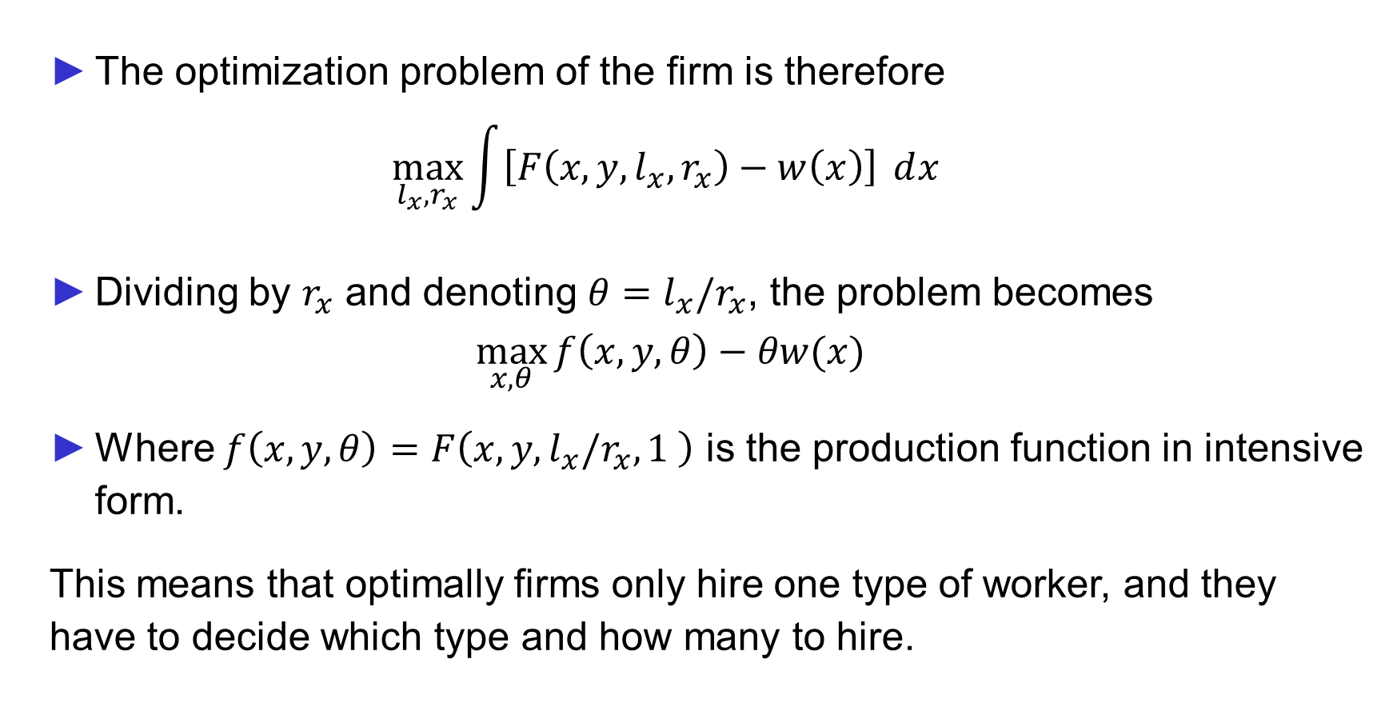
Model
The optimization problem of the firm is therefore
$$\max_{l_{x},r_{x}}{\int{\left[F\left(x,y,l_{x},r_{x}\right)−w\left(x\right)\right]} ⅆx }$$
Dividing by $r_{x}$ and denoting ${θ=l_{x}/r}_{x}$, the problem becomes
$$\max_{x,θ}{f\left(x,y,θ\right)−θw(x)}$$
Where $f\left(x,y,θ\right)=F\left(x,y,l_{x}/r_{x},1 \right)$ is the production function in intensive form.
This means that optimally firms only hire one type of worker, and they have to decide which type and how many to hire.

Slide 4
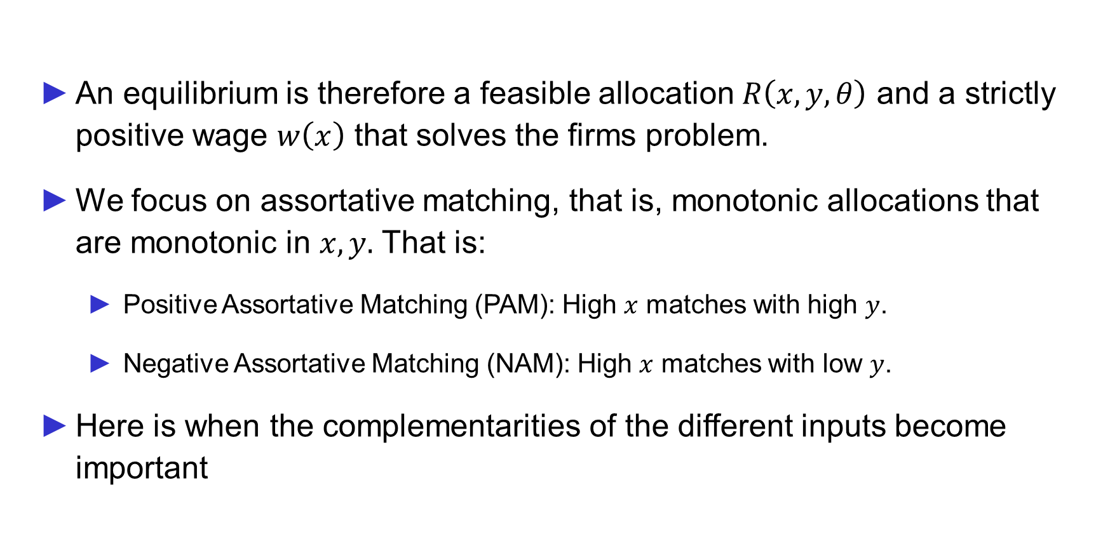
Assortative Matching
An equilibrium is therefore a feasible allocation $R\left(x,y,θ\right)$ and a strictly positive wage $w\left(x\right)$ that solves the firms problem.
We focus on assortative matching, that is, monotonic allocations that are monotonic in $x,y.$ That is:
Positive Assortative Matching (PAM): High $x$ matches with high $y$.
Negative Assortative Matching (NAM): High $x$ matches with low $y$.
Here is when the complementarities of the different inputs become important

Slide 5
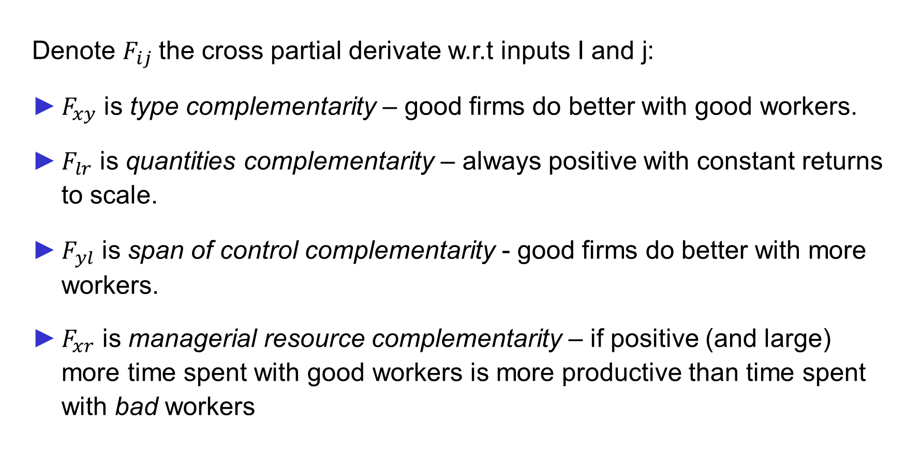
Input Complementarities
Denote $F_{ij}$ the cross partial derivate w.r.t inputs I and j:
$F_{xy}$ is type complementarity – good firms do better with good workers.
$F_{lr}$ is quantities complementarity – always positive with constant returns to scale.
$F_{yl}$ is span of control complementarity - good firms do better with more workers.
$F_{xr}$ is managerial resource complementarity – if positive (and large) more time spent with good workers is more productive than time spent with bad workers

Slide 6
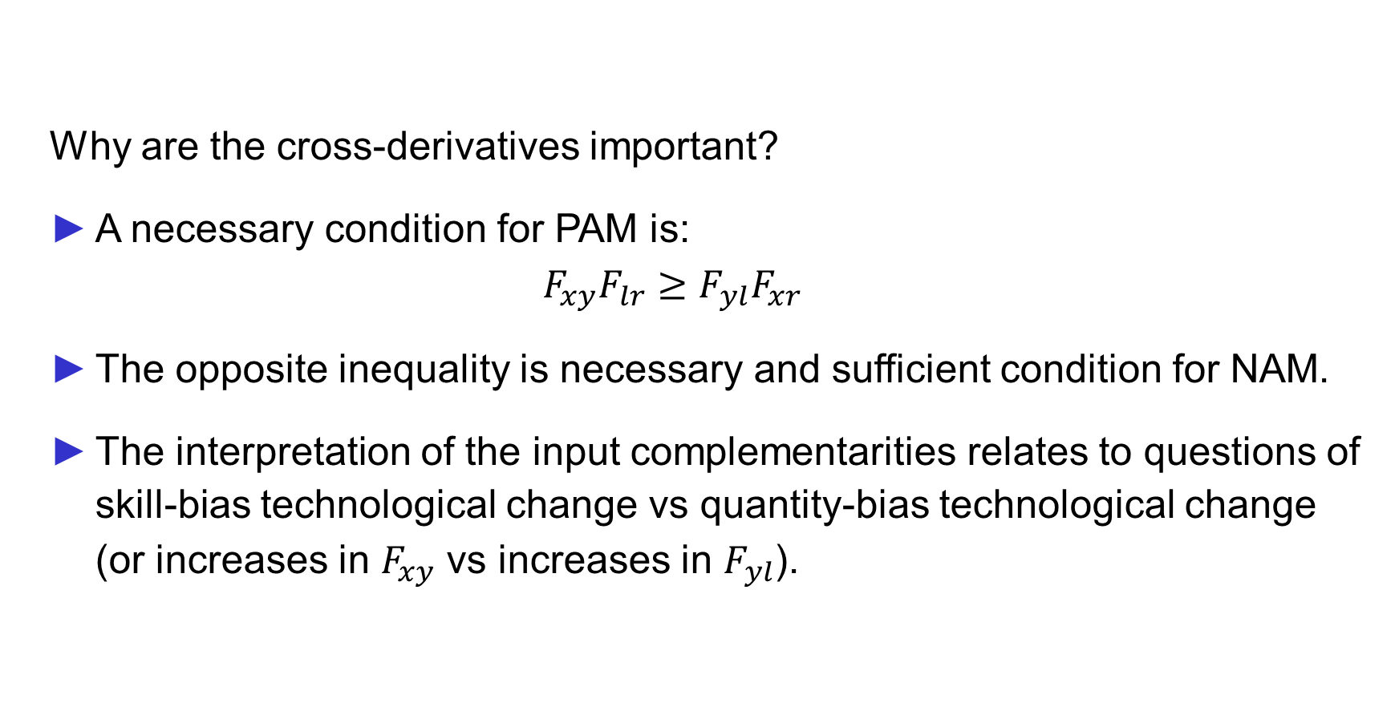
Input Complementarities
Why are the cross-derivatives important?
A necessary condition for PAM is:
$$F_{xy}F_{lr}≥F_{yl}F_{xr}$$
The opposite inequality is necessary and sufficient condition for NAM.
The interpretation of the input complementarities relates to questions of skill-bias technological change vs quantity-bias technological change (or increases in $F_{xy}$ vs increases in $F_{yl}$).

Slide 7
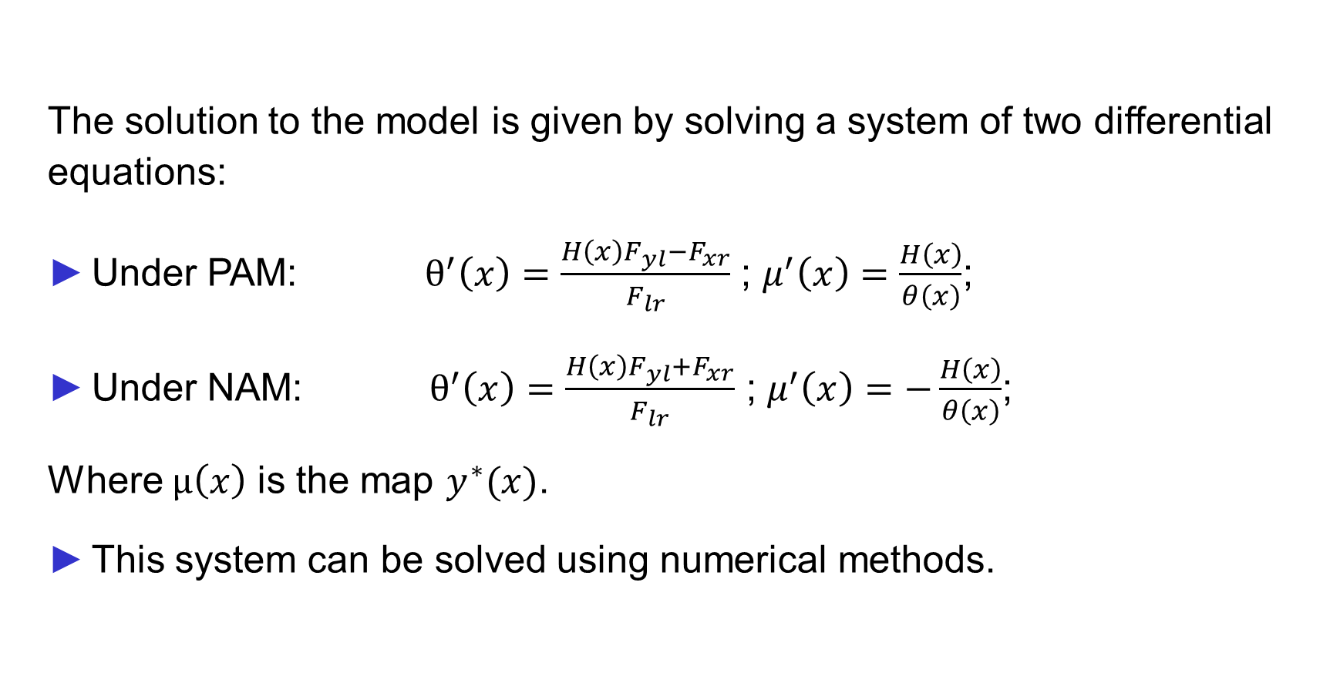
Solving the Model
The solution to the model is given by solving a system of two differential equations:
Under PAM: $θ^{′}\left(x\right)=\frac{H\left(x\right)F_{yl}−F_{xr}}{F_{lr}}$ ; $μ^{′}\left(x\right)=\frac{H\left(x\right)}{θ\left(x\right)}$;
Under NAM: $θ^{′}\left(x\right)=\frac{H\left(x\right)F_{yl}+F_{xr}}{F_{lr}}$ ; $μ^{′}\left(x\right)=−\frac{H\left(x\right)}{θ\left(x\right)}$;
Where $μ\left(x\right)$ is the map $y^{∗}(x)$.
This system can be solved using numerical methods.

Slide 8
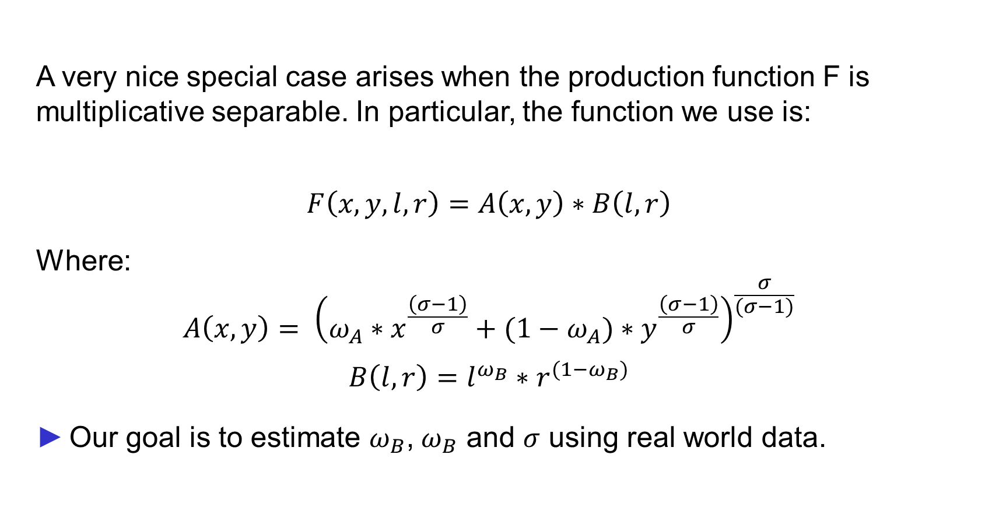
A Special Case
A very nice special case arises when the production function F is multiplicative separable. In particular, the function we use is:
$$F\left(x,y,l,r\right)=A\left(x,y\right)∗B\left(l,r\right)$$
Where:
$$A\left(x,y\right)= {\left(ω_{A}∗x^{\frac{\left(σ−1\right)}{σ}}+(1−ω_{A})∗y^{\frac{\left(σ−1\right)}{σ}}\right)}^{\frac{σ}{(σ−1)}}$$
$$B\left(l,r\right)=l^{ω_{B}}∗r^{(1−ω_{B})}$$
Our goal is to estimate $ω_{B}$, $ω_{B}$ and $σ$ using real world data.

Slide 9
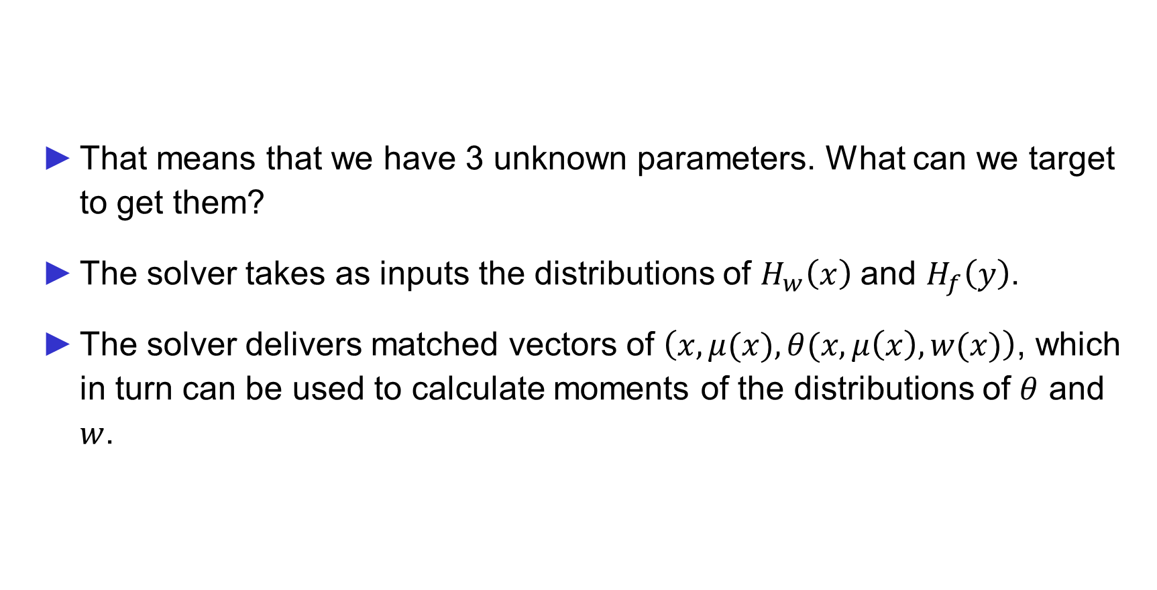
Targets for estimation
That means that we have 3 unknown parameters. What can we target to get them?
The solver takes as inputs the distributions of $H_{w}\left(x\right)$ and $H_{f}\left(y\right)$.
The solver delivers matched vectors of $\left(x,μ(x),θ(x,μ\left(x\right), w(x)\right)$, which in turn can be used to calculate moments of the distributions of $θ$ and $w$.

Slide 10

Targets for estimation
The idea is to estimate $H_{w}\left(x\right)$ and $H_{f}\left(y\right)$ from the data, and also get a distribution of firm size and

Slide 11
Choice of variables
Not employer-employee matched data by construction.
But the unique identifiers for firms and workers allow us to build it that way.
This means that, unfortunately, we have to drop unmatched workers and firms.
Good news is that the data set is already very big, so even when dropping unmatched data, it is still a big sample.

Slide 12
Choice of variables
Model variable | Data variable | Alternatives
Worker Skill | Education level (0 to 6) (illiterate to PhD) | Log Wages Wage regression residual
Manager Skill | Log Average Reported Profits (assumes same distribution as profits)
Firm Size | Firm size (in workers)
Wages (return to worker skill) | Average Daily Wages
Profits (return to manager skill) | Average Reported Profits

Slide 13
Descriptive statistics
 | Mean | Standard Deviation | Min | Max | Median | 90th percentile | Obs
Education | 2.166434 | 1.017146 | 0 | 6 | 2 | 3 | 552,364
Av wage | 15,519.59 | 16,691.64 | .01 | 1,733,613 | 12,988.59 | 30,602.05 | 374,717
Av wage (daily) | 58.06863 | 249.641 | 0.00003 | 68,373.84 | 43.39396 | 91.57422 | 319,919
Av profit | 7,187.25 | 27,099.97 | .01 | 3,005,061 | 1,829.724 | 17,724.17 | 27,225

Slide 14
Descriptive statistics
 | mean | sd | min | max | median | 90th percentile | N
Number of workers | 19.10815 | 255.9593 | 0 | 96,402 | 5 | 37 | 376,891
Firm age | 9.262611 | 9.61008 | 0 | 105.737 | 6.00274 | 21.51233 | 353,072
Av profit | 3,601.598 | 16,809.16 | .01 | 3,005,061 | 761.25 | 8,235.29 | 64,817
Av wage | 8,865.947 | 10,613.06 | .01 | 733,636.4 | 6,552.8 | 18,487.82 | 255,872
Av wage (daily) | 41.5741 | 92.41269 | .0001111 | 26,461.27 | 35.97185 | 63.53 | 250,344
Av worker education | 1.987123 | .87669 | 0 | 6 | 2 | 3 | 342,023
Number of firms with some income information |  |  |  | 403,372

